Slide 1
Insurance Policy Management System (IPMS)
RLL @ Group 8

Slide 2
Team Members
1. Aryan - 2563008
2. Shubham - 2563633 3. Tesenlo - 2563616
4.Dinakar - 2563359
5. Pavan - 2563688
6. Anniesh - 2563179
7.Vankatesan - 2563702
8.Nowshin - 2563681
9. Sonia - 2562927

Slide 3
Objective
To Create a dynamic and responsive web application for managing the insurance policies application online

Slide 4
What Is Insurance & IPMS
Insurance will help the families in maintaining their standard of living in case if we are not around in the future.
Insurance is all about providing financial safety to the individual or Vehicles.
It helps us to enjoy financial security.
IMPS is an software/application to access and manage different kind of policies available in market.

Slide 5
INTRODUCTION
We have created an application for administrators and users, the main goal is to create a safe and powerful insurance management system.
The web application effectively manages customer history and policy information for easy access.
We have also provided the feature of 24X7 Support available for Customers

Slide 6
ADMIN MODULES
Login into portal
View customers
View/add/update/delete policy
View/add/update/delete policy category
Approve/disapprove policy applied by customer
View all customers and their policy statements
View queries of customer

Slide 7
USER MODULES
Create account and login
Update personal details
View all policies
Apply for any policy
View policy history
Post queries
Contact US

Slide 8
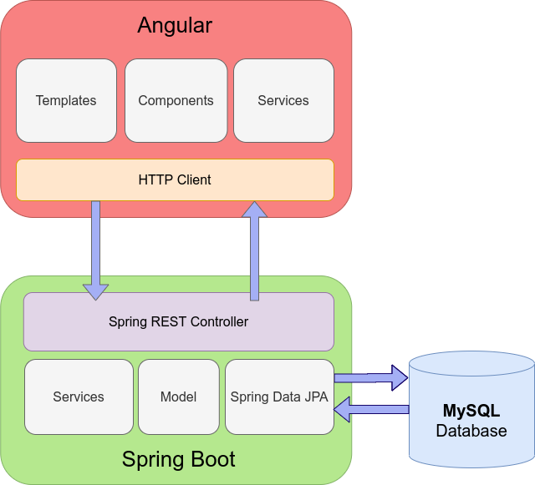
ARCHITECTURE/ SCHEMA

Slide 9
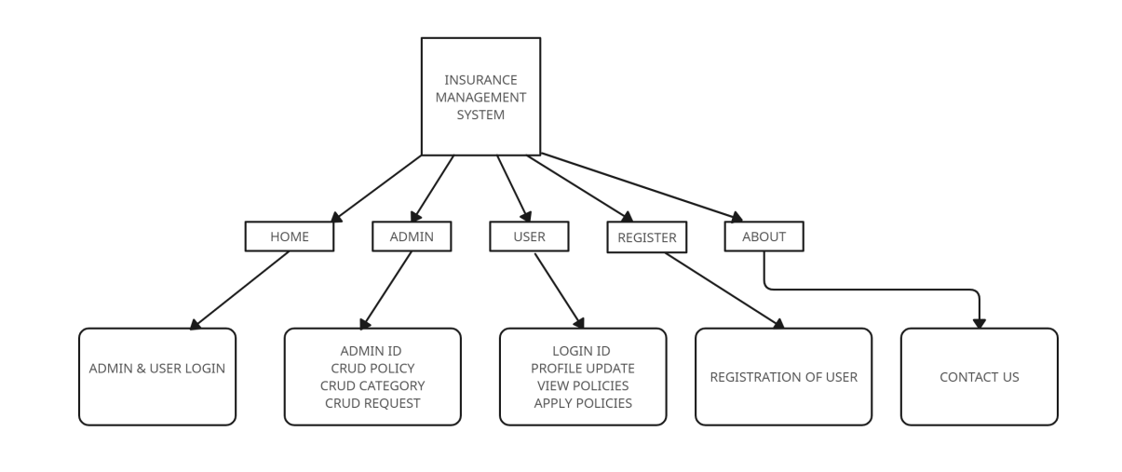
BLOCK DIAGRAM

Slide 10
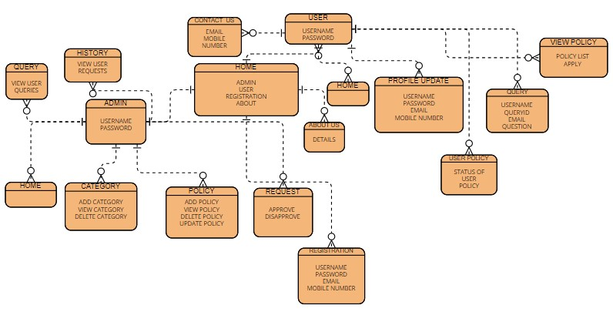
ER DIAGRAM

Slide 11





TECHNOLOGIES USED
FRONTEND- Angular
BACKEND- Spring Boot
DATABASE- Mysql + HIbernate
SERVER- Apache Tomcat

Slide 12
TECHNOLOGY INFO
ANGULAR- Angular is a platform and framework for building single-page client applications using HTML and TypeScript. Angular is written in TypeScript. It implements core and optional functionality as a set of TypeScript libraries that you import into your applications.
SPRING BOOT-
Java Spring Boot is an open-source tool that makes it easier to use Java-based frameworks to create microservices and web apps. For any definition of Spring Boot, the conversation has to start with Java—one of the most popular and widely used development languages and computing platforms for app development.

Slide 13
TECHNOLOGY INFO
MYSQL-
Databases are the essential data repository for all software applications. For example, whenever someone conducts a web search, logs in to an account, or completes a transaction, a database system is storing the information so it can be accessed in the future
SPRING JPA-
JPA is a specification which specifies how to access, manage and persist information/data between java objects and relational databases. It provides a standard approach for ORM, Object Relational Mapping. Spring Boot provides a seemless integration with JPA.

Slide 14
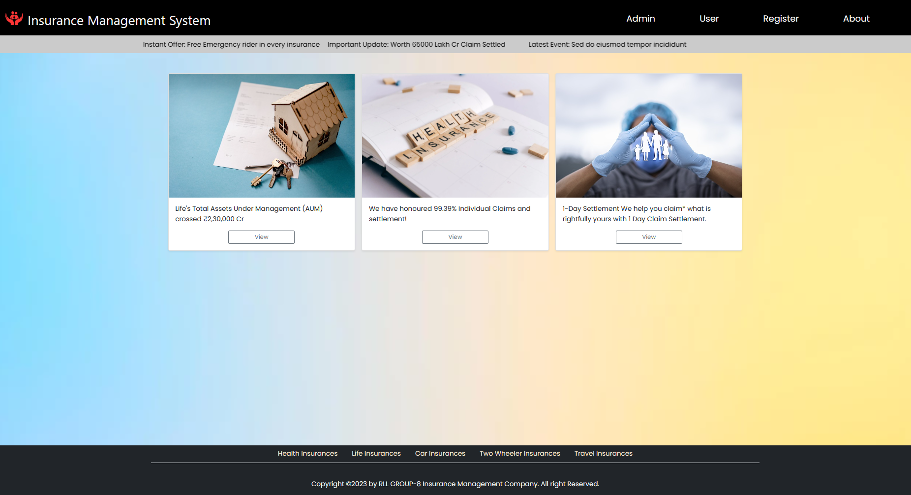
PROJECT DEMO (HOMEPAGE)

Slide 15
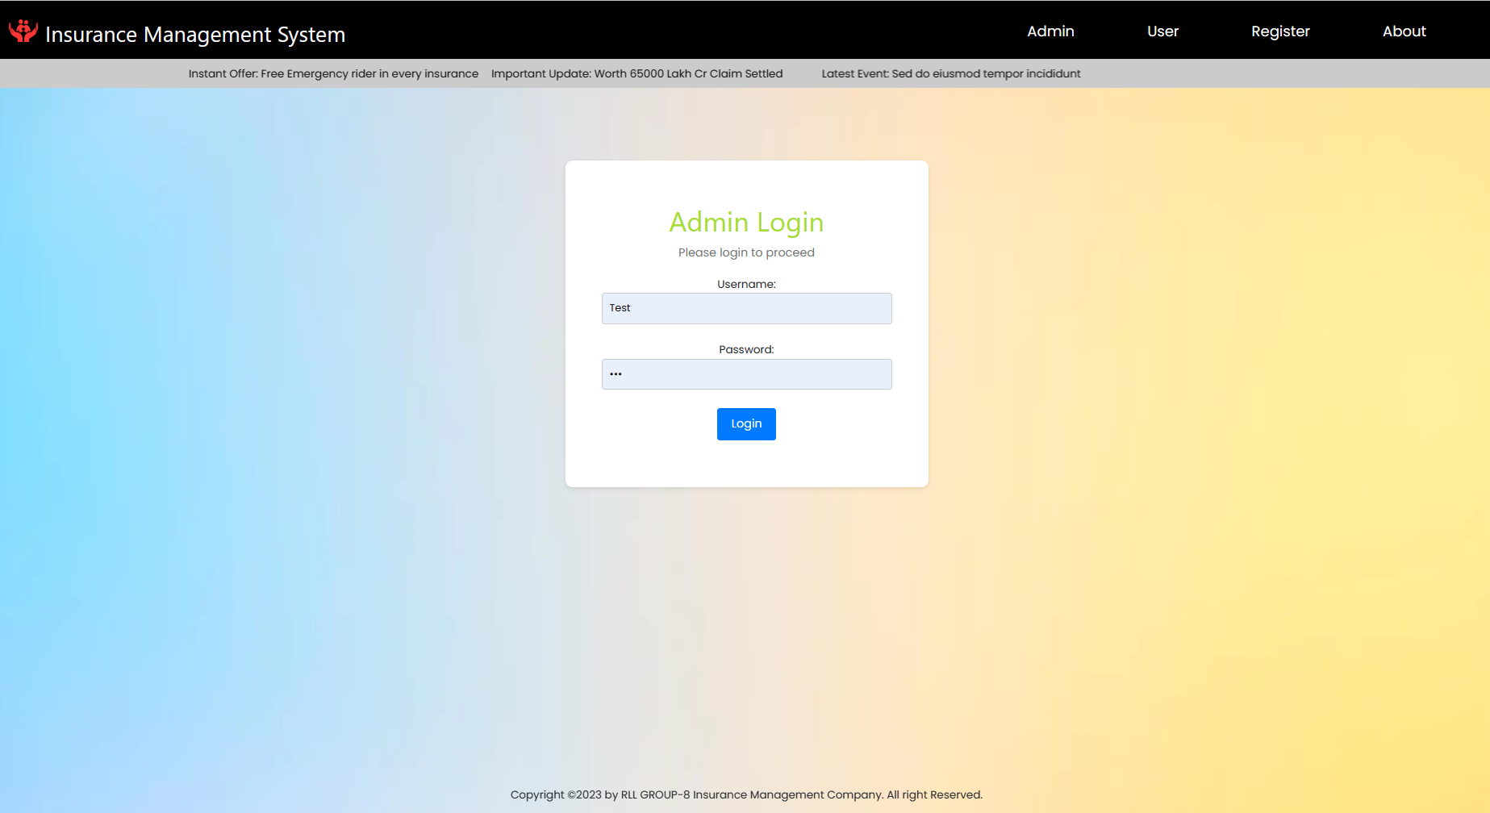
ADMIN LOGIN

Slide 16
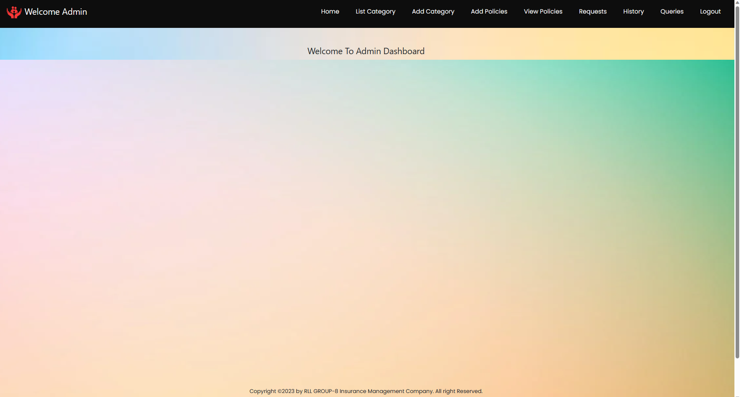
ADMIN HOME

Slide 17
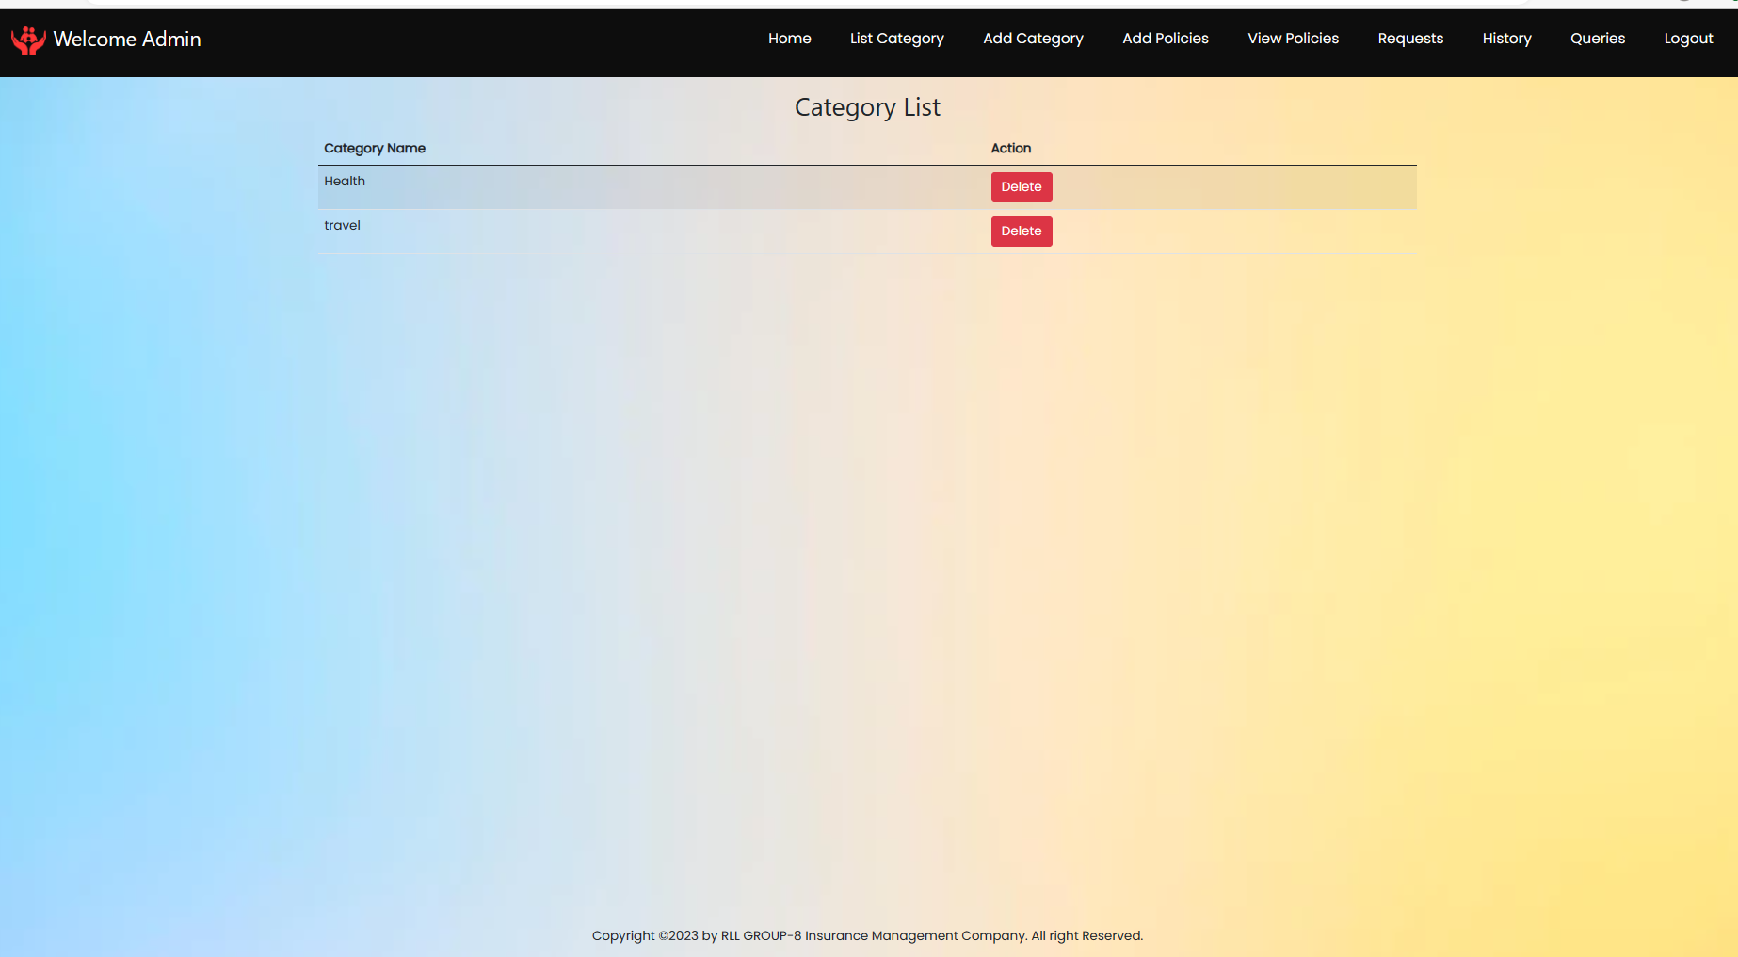
CATEGORIES LIST

Slide 18
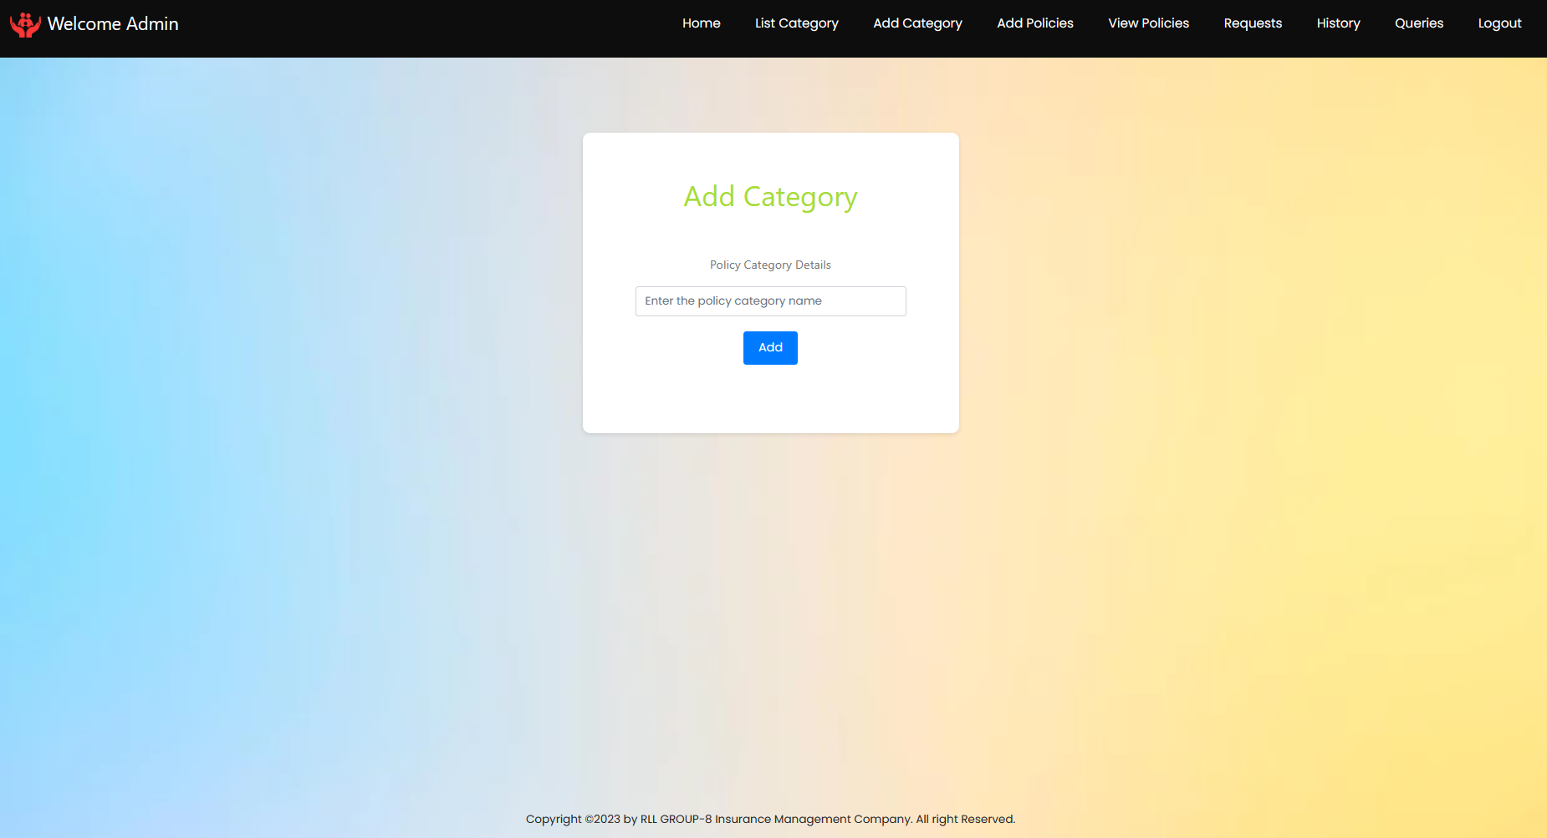
ADD CATEGORY

Slide 19
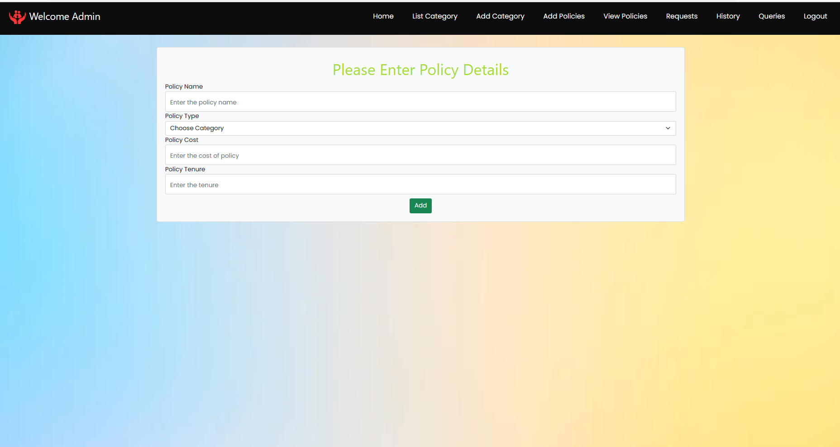
ADD POLICY

Slide 20
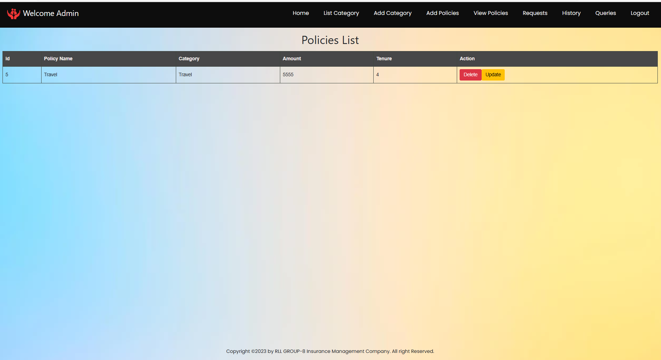
VIEW POLICY

Slide 21
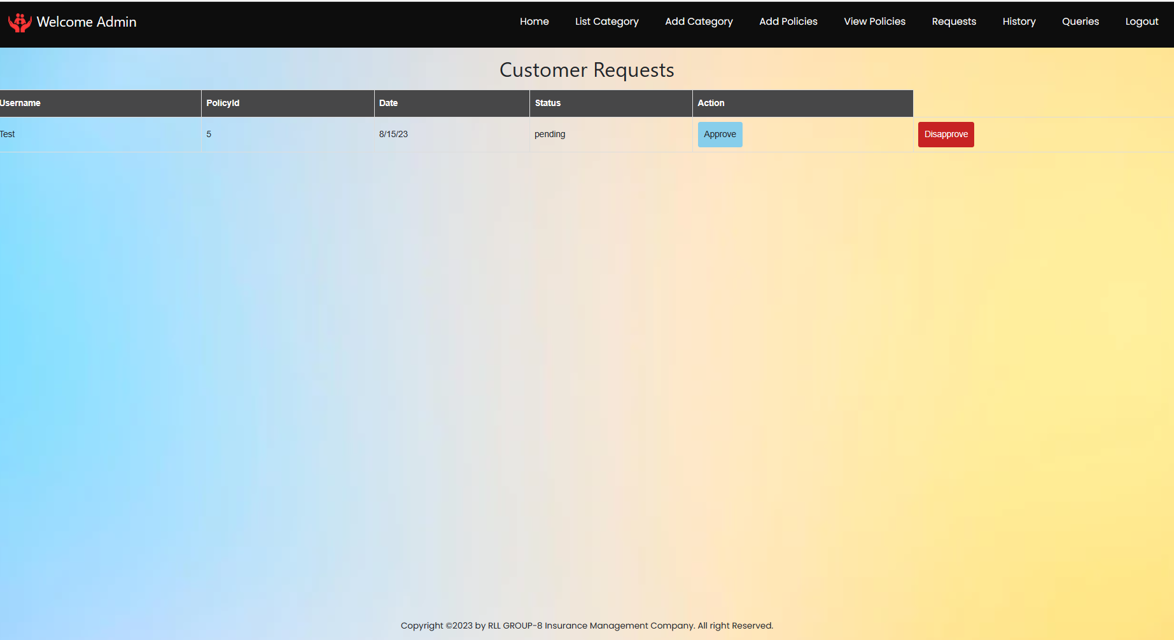
APPROVE/DISAPPROVE REQUEST

Slide 22
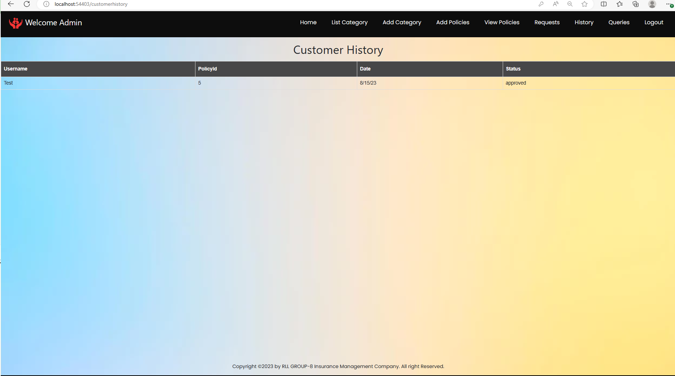
HISTORY

Slide 23
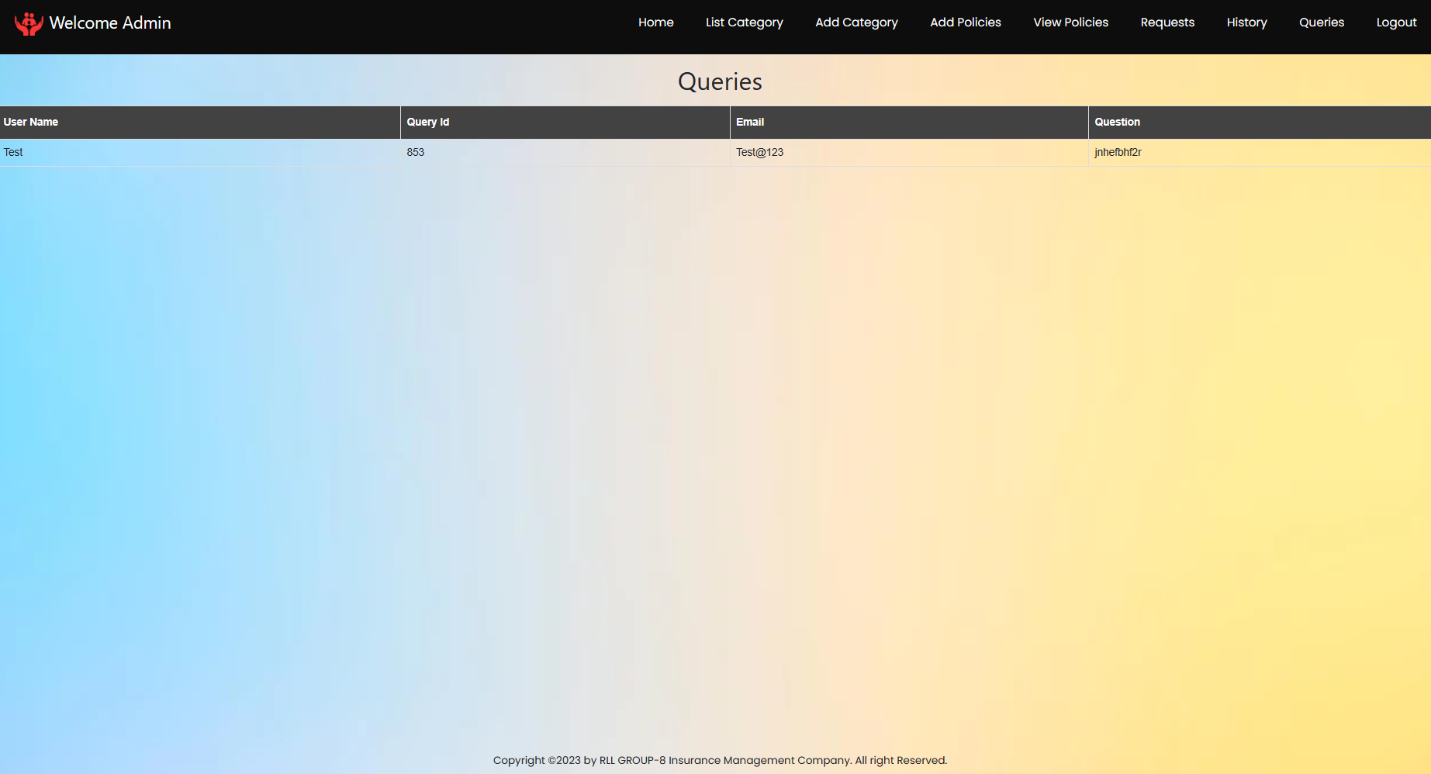
QUERIES

Slide 24
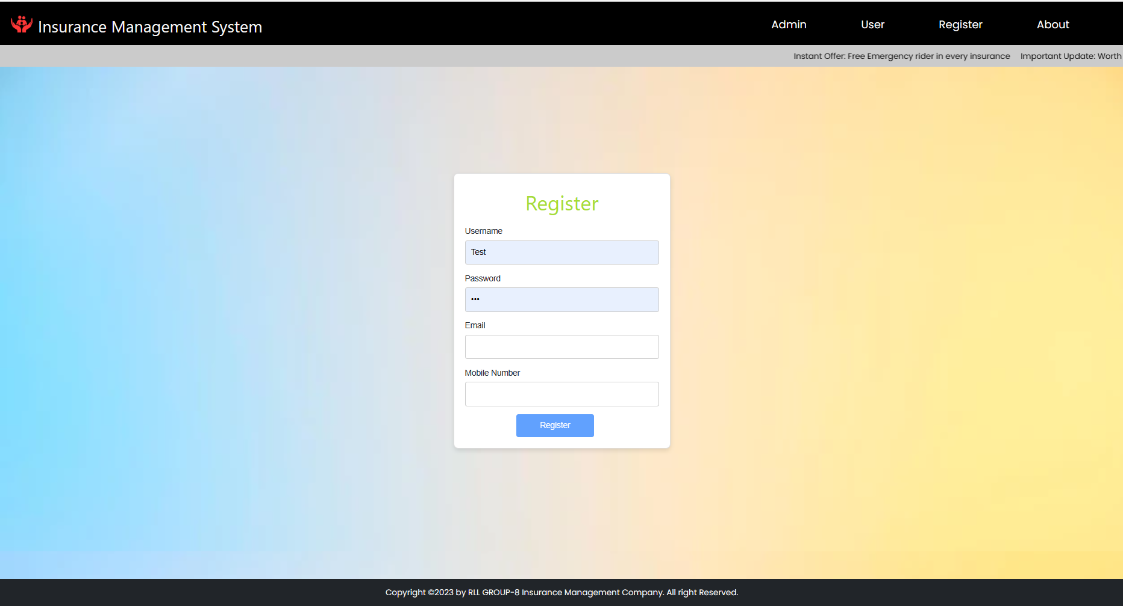
REGISTER USER

Slide 25
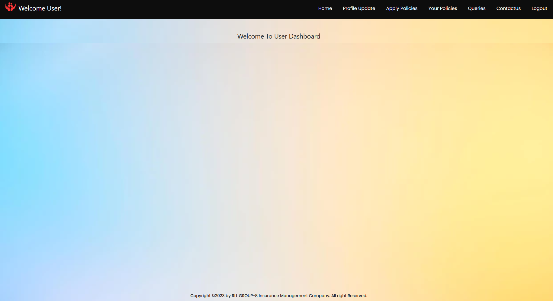
USER HOMEPAGE

Slide 26
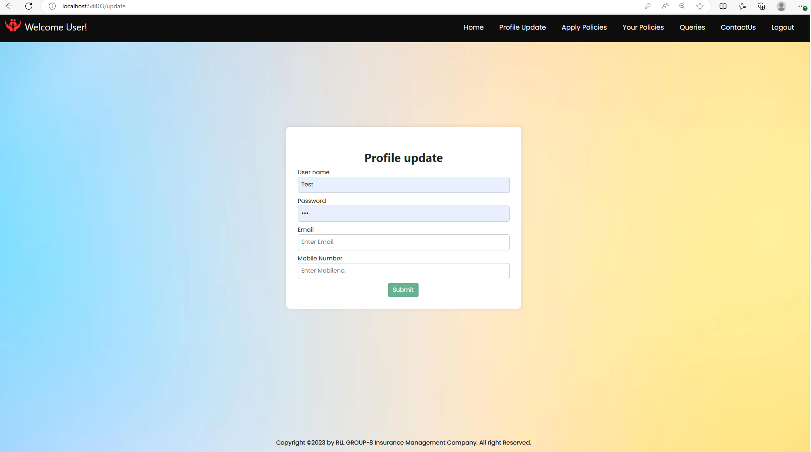
PROFILE UPDATE

Slide 27
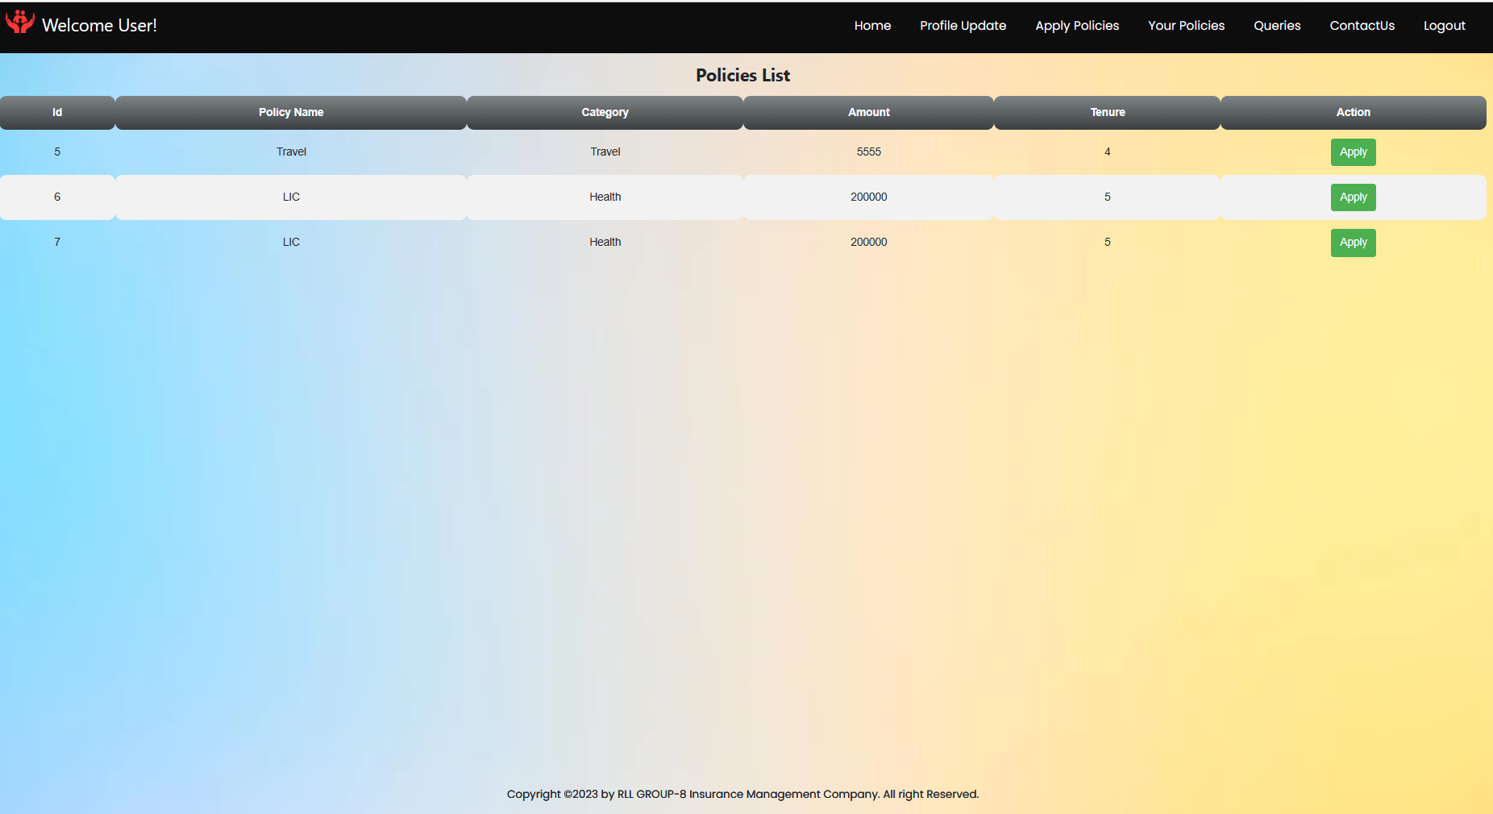
APPLY POLICY

Slide 28
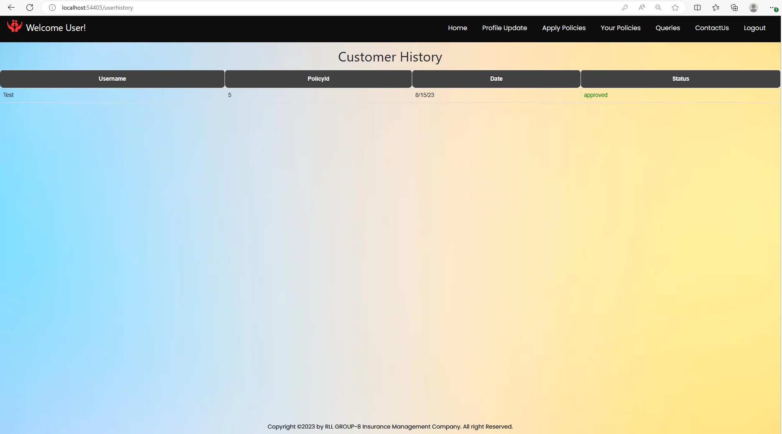
CUSTOMER APPLIED POLICIES/ HISTORY

Slide 29
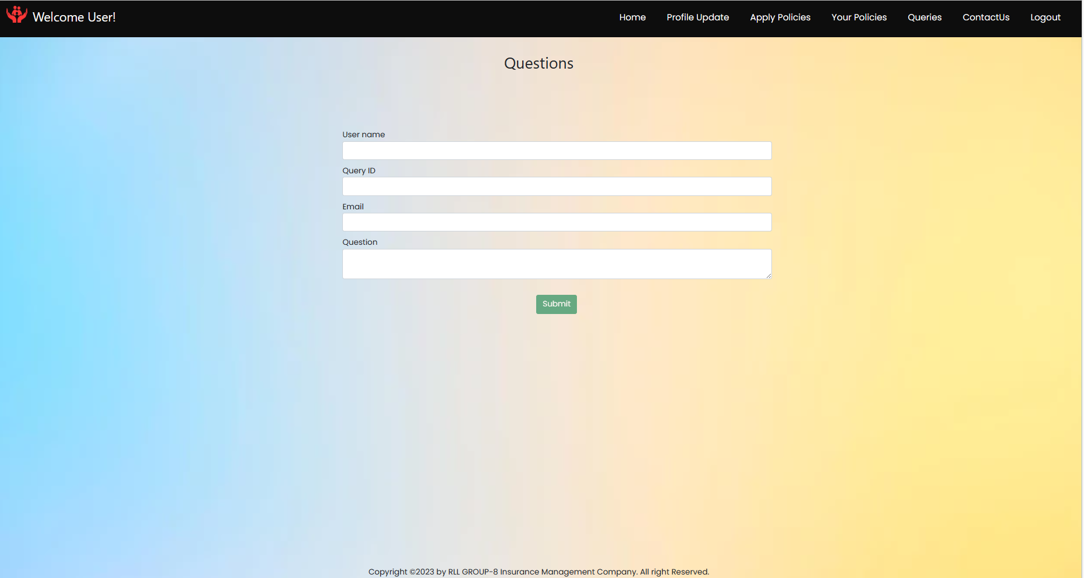
QUERIES FORM

Slide 30
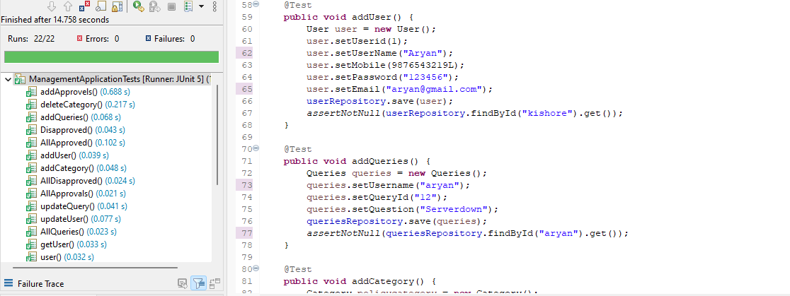
JUNIT Testing

Slide 31
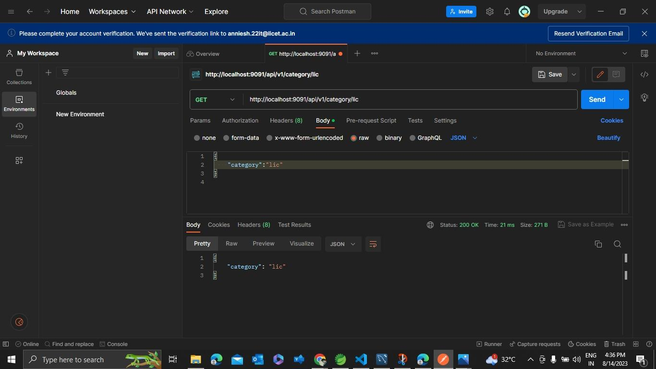
POSTMAN TESTING

Slide 32
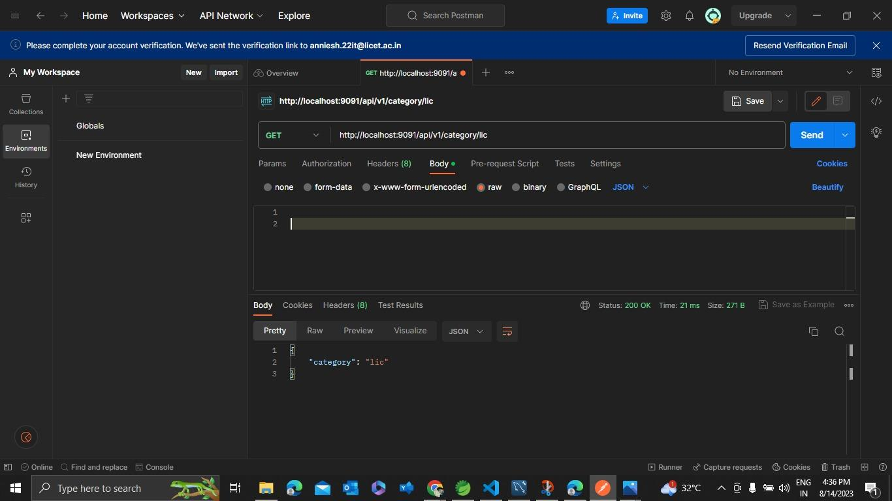

Slide 33
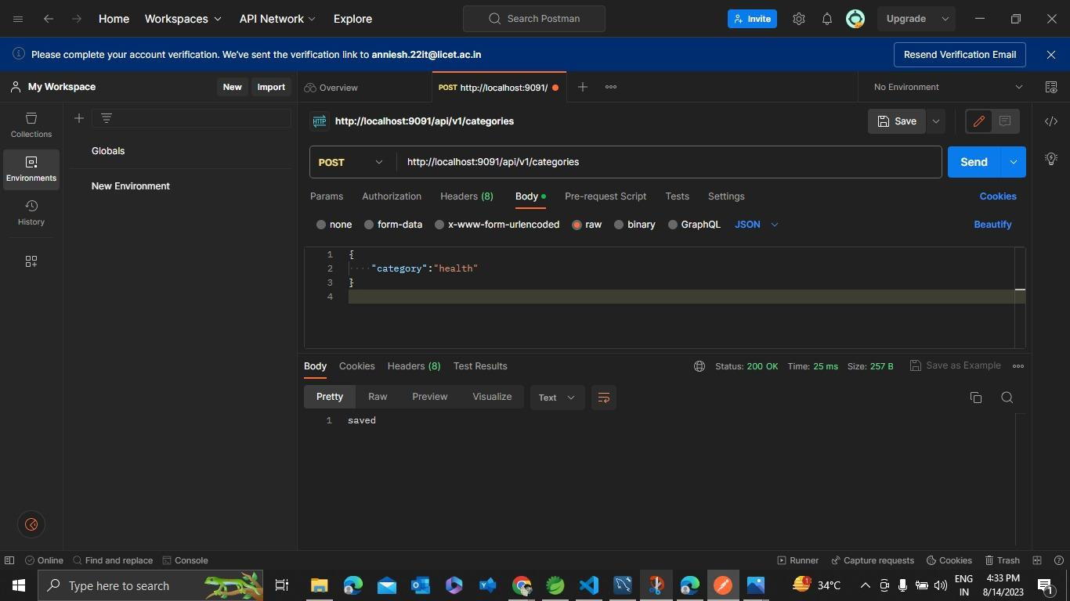

Slide 34
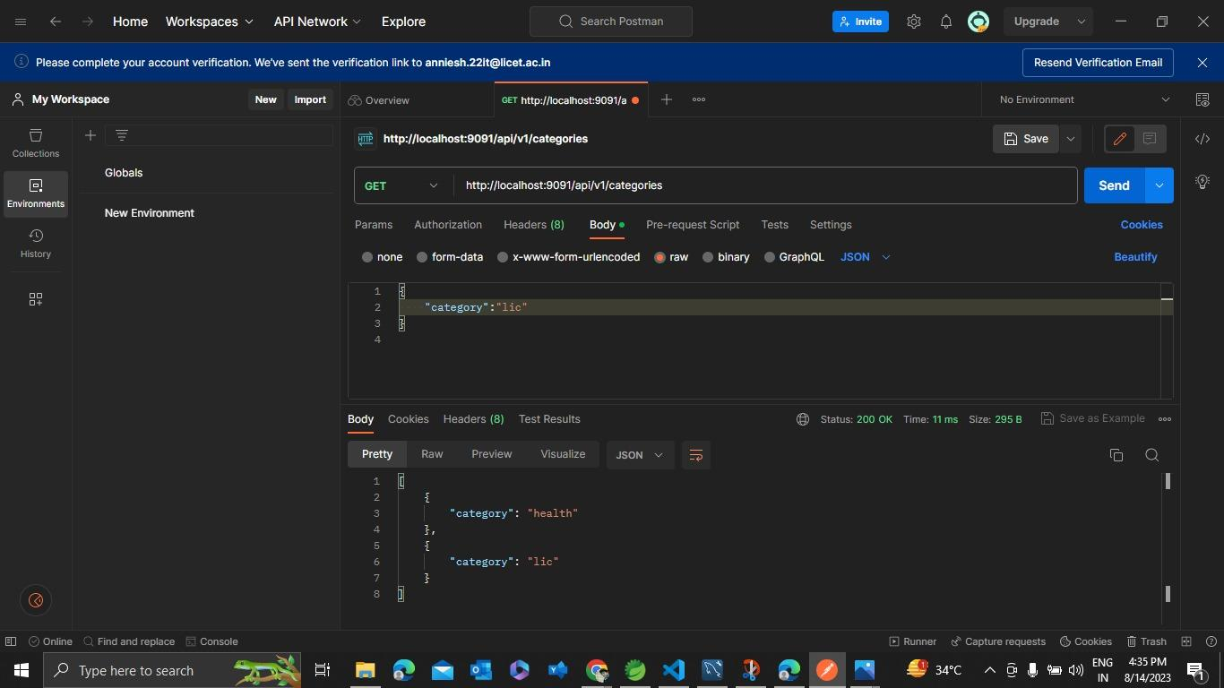

Slide 35
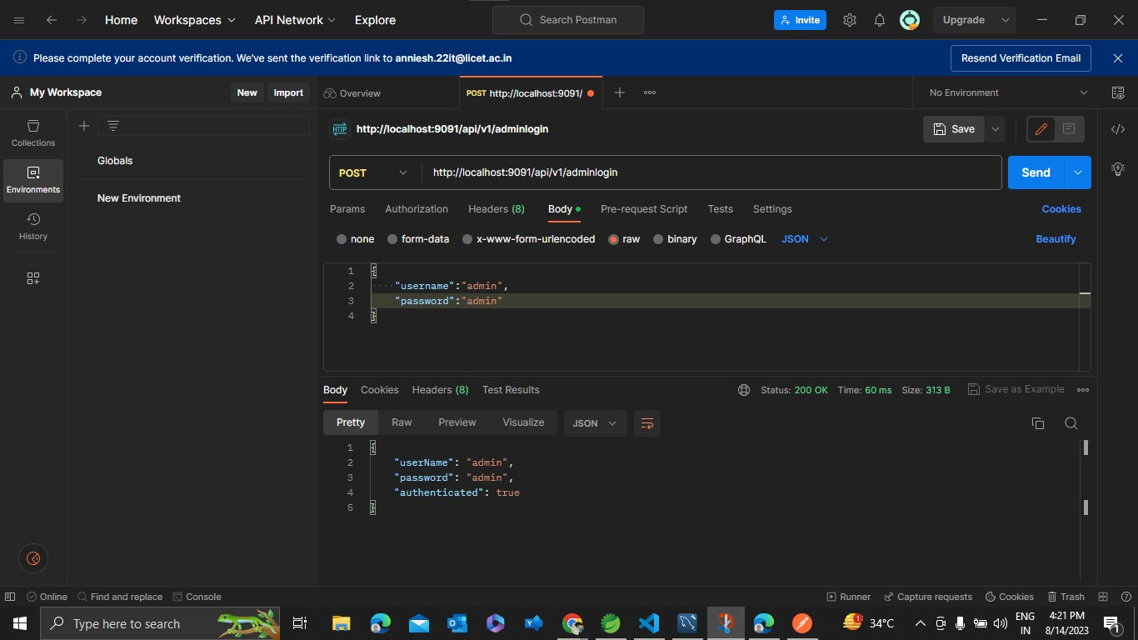

Slide 36
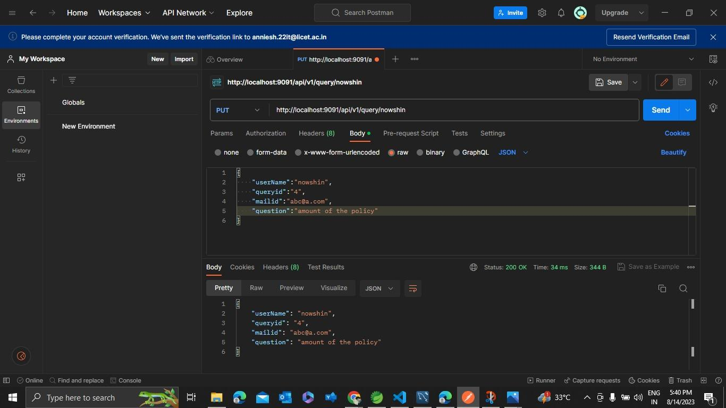

Slide 37
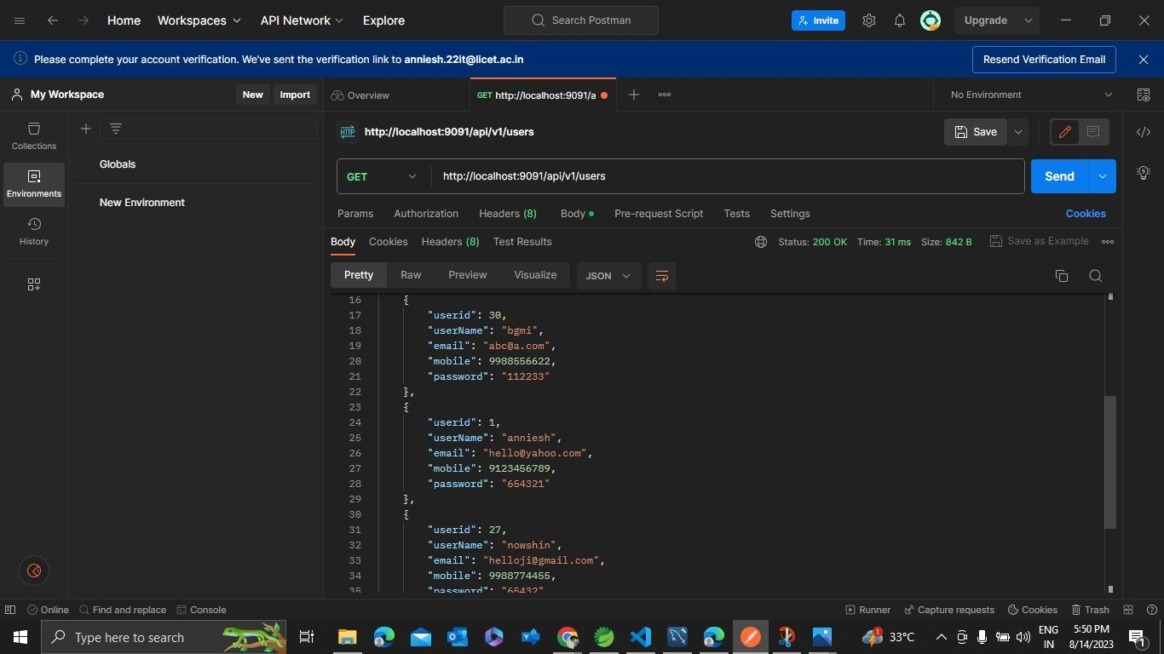

Slide 38
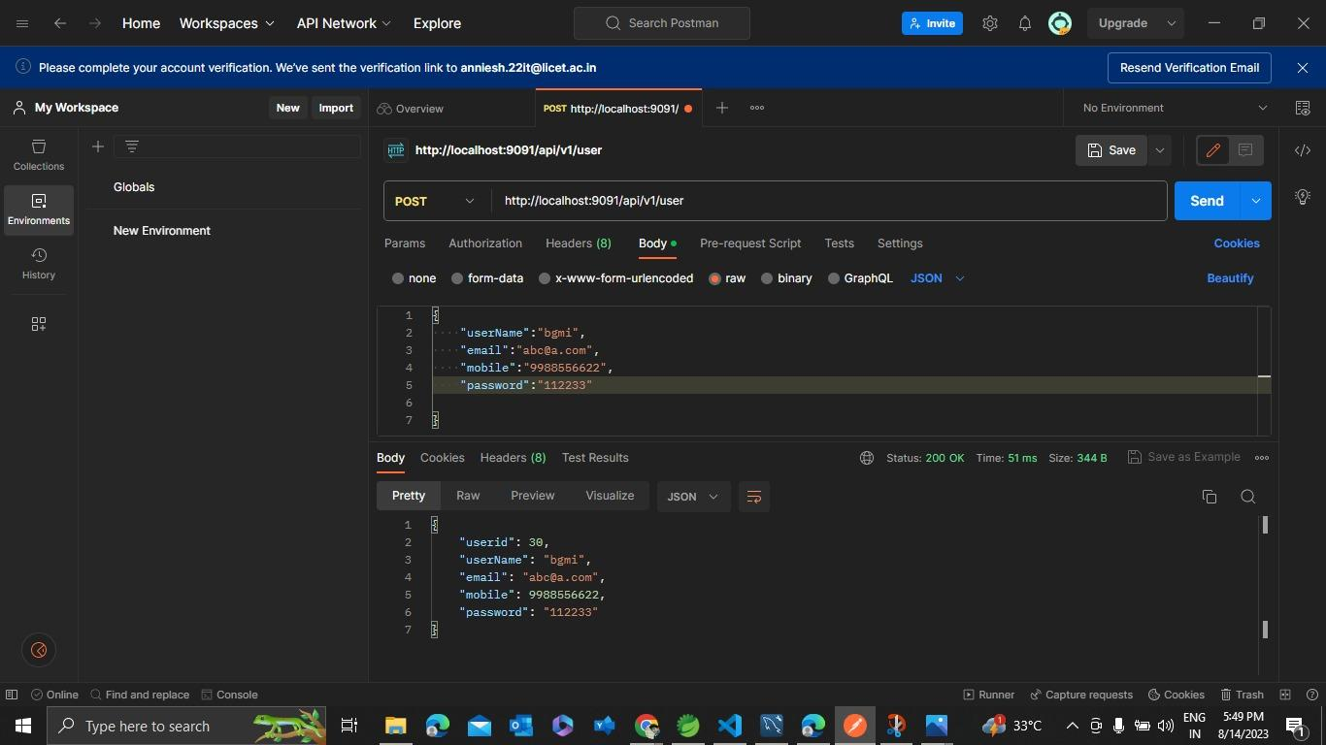

Slide 39
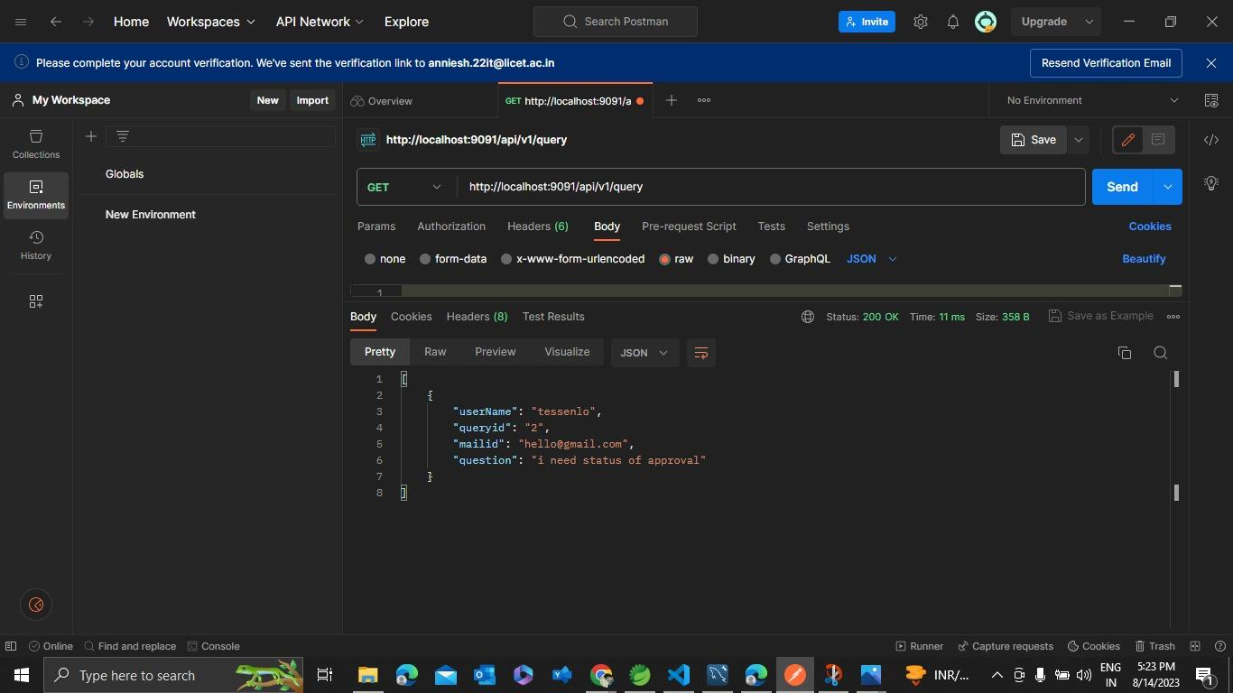

Slide 40
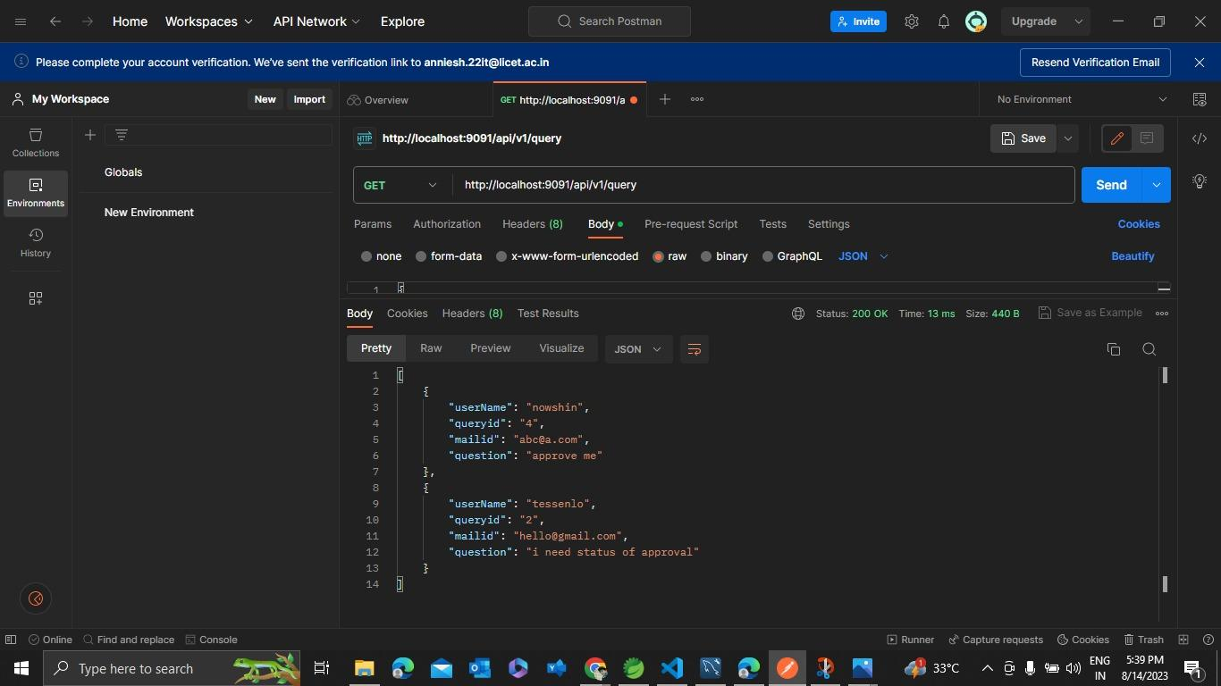

Slide 41
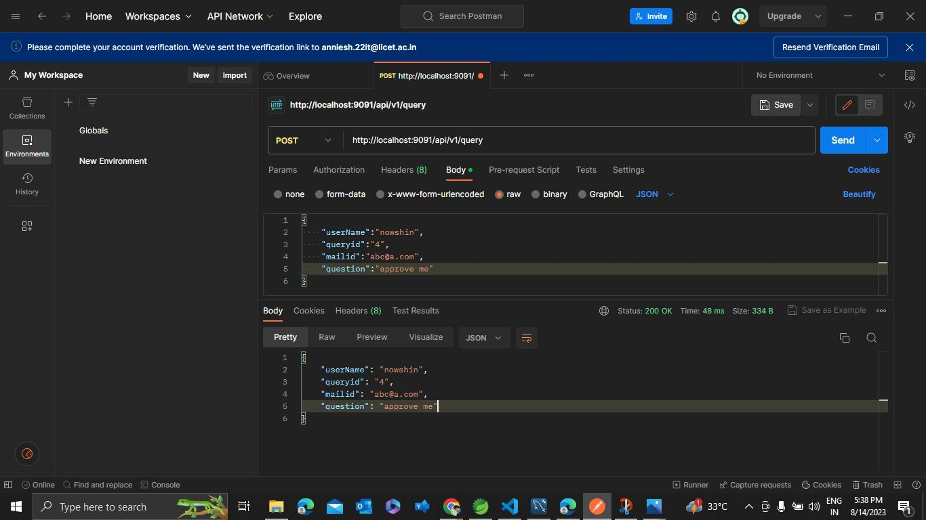

Slide 42
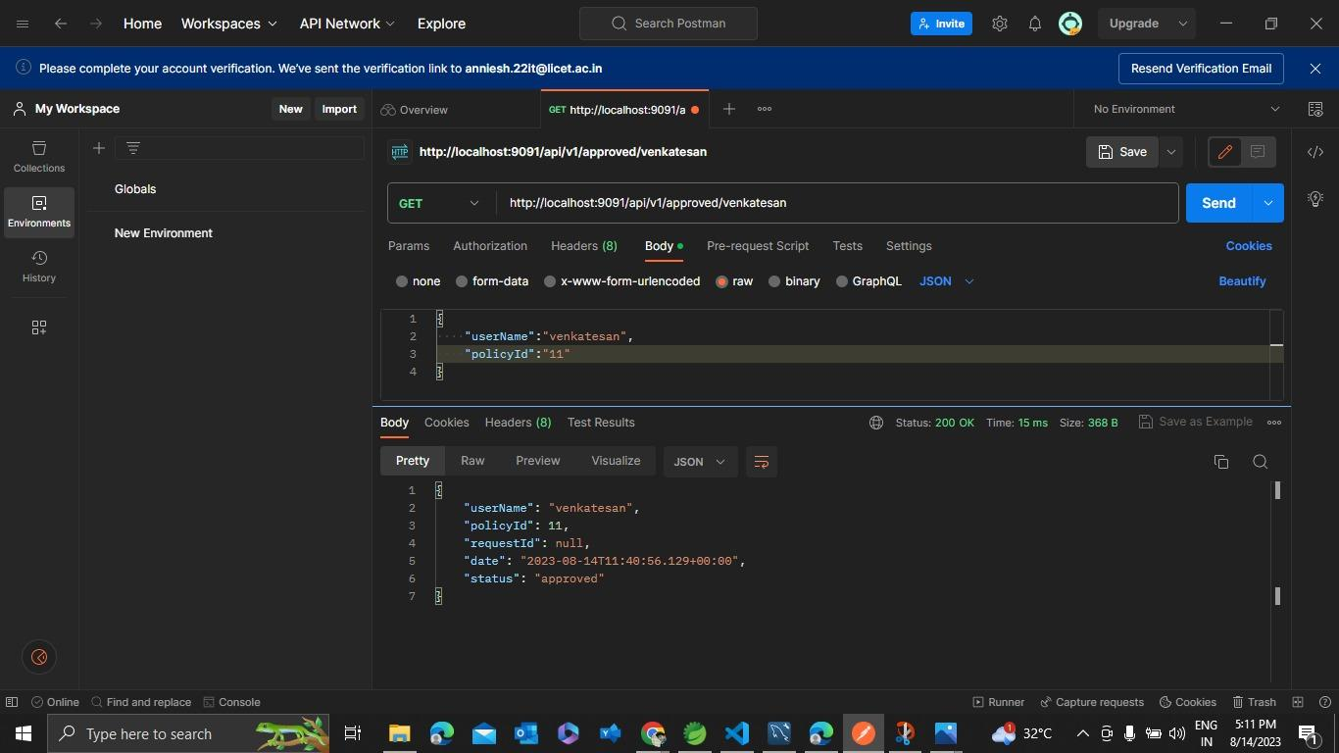

Slide 43
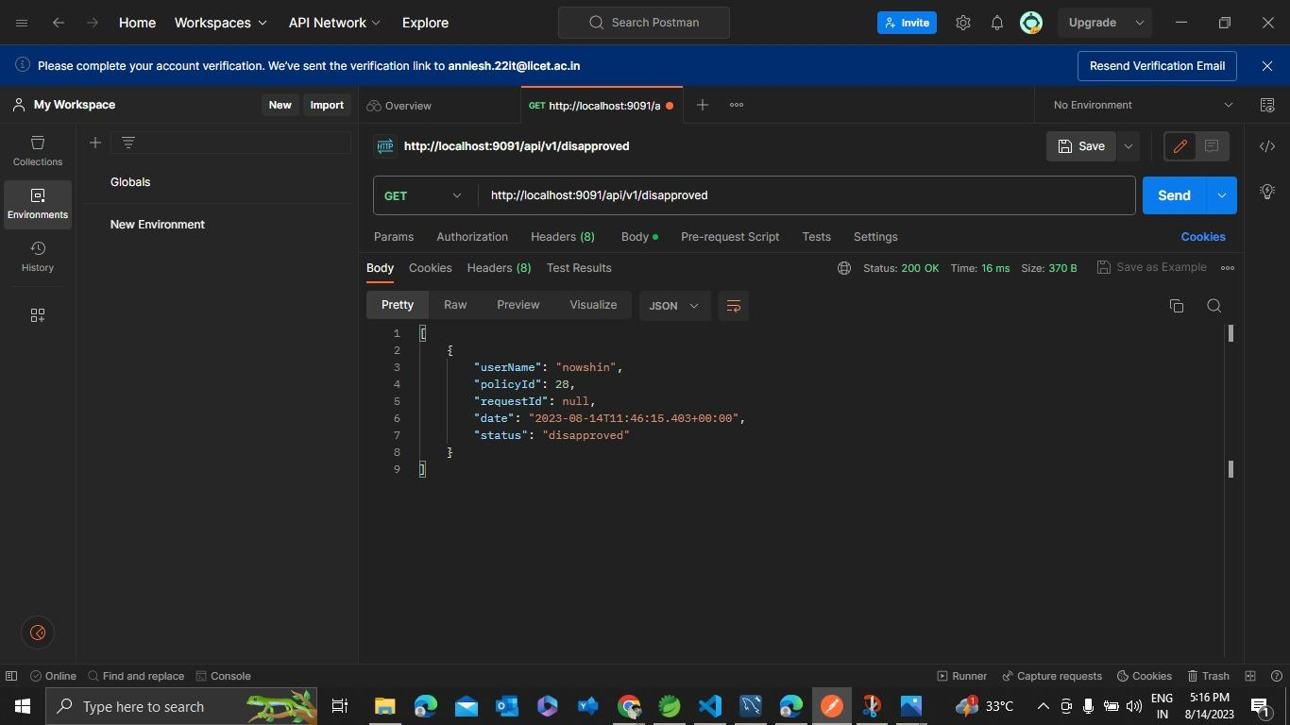

Slide 44


Slide 45
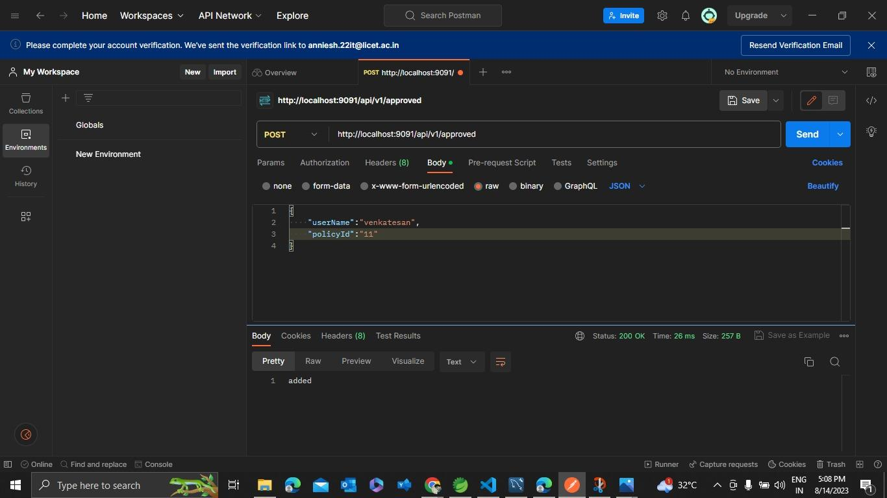

Slide 46
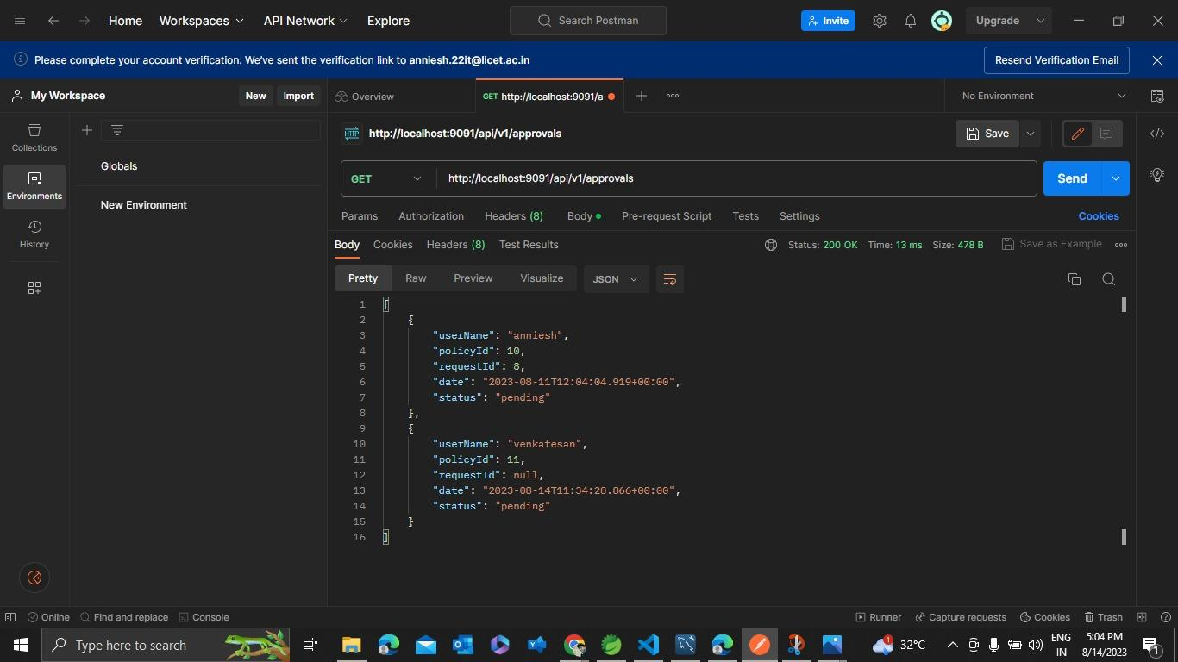

Slide 47
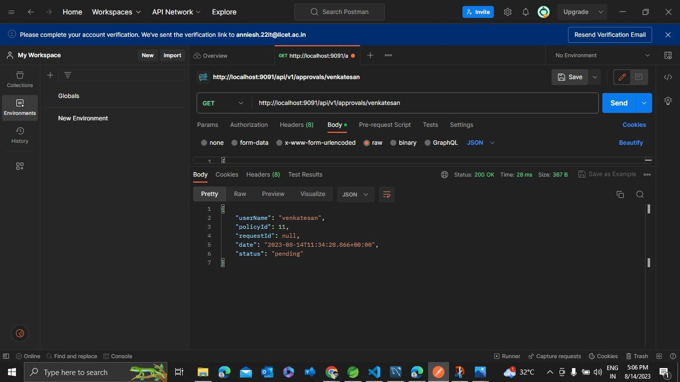

Slide 48
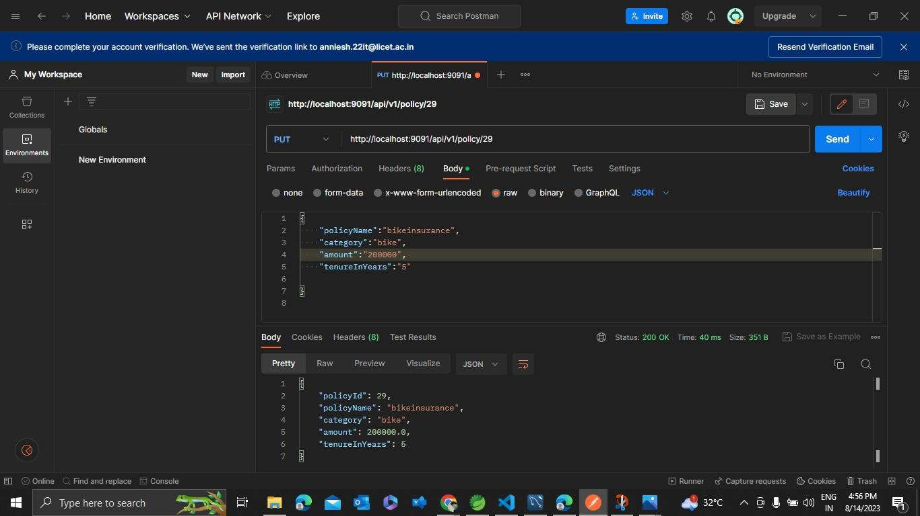

Slide 49
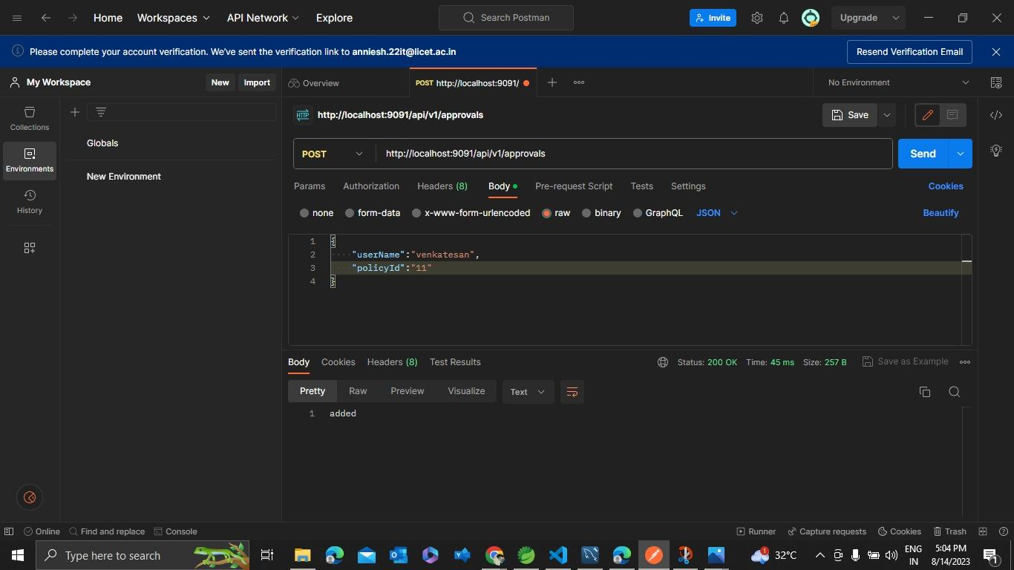

Slide 50
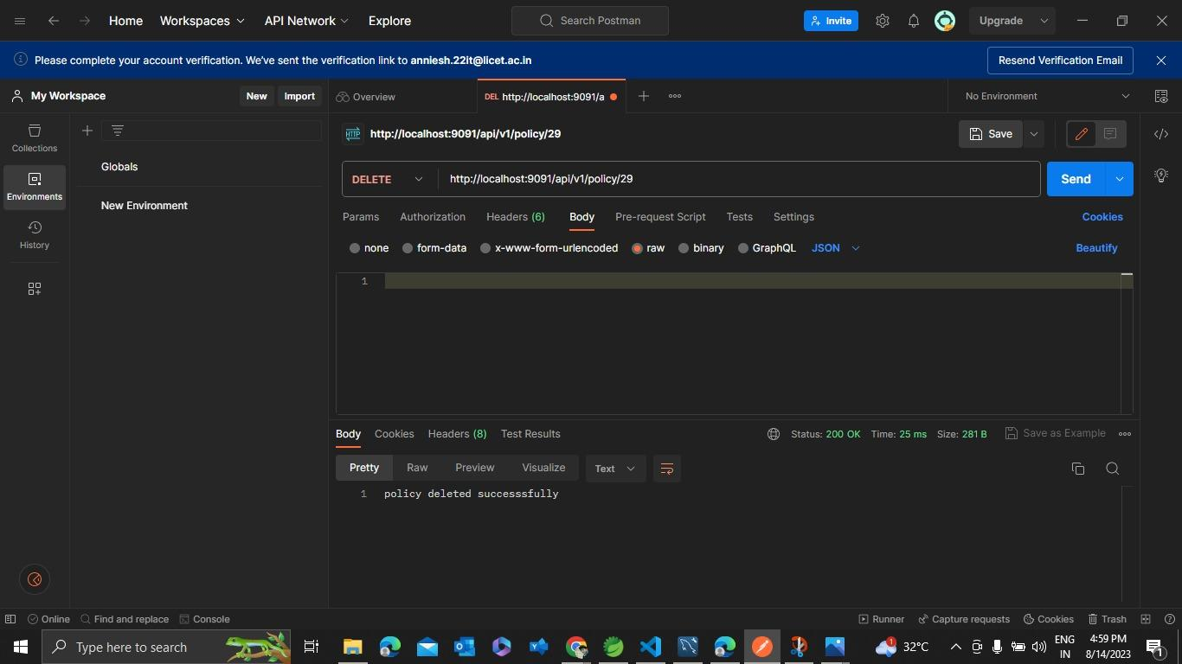

Slide 51
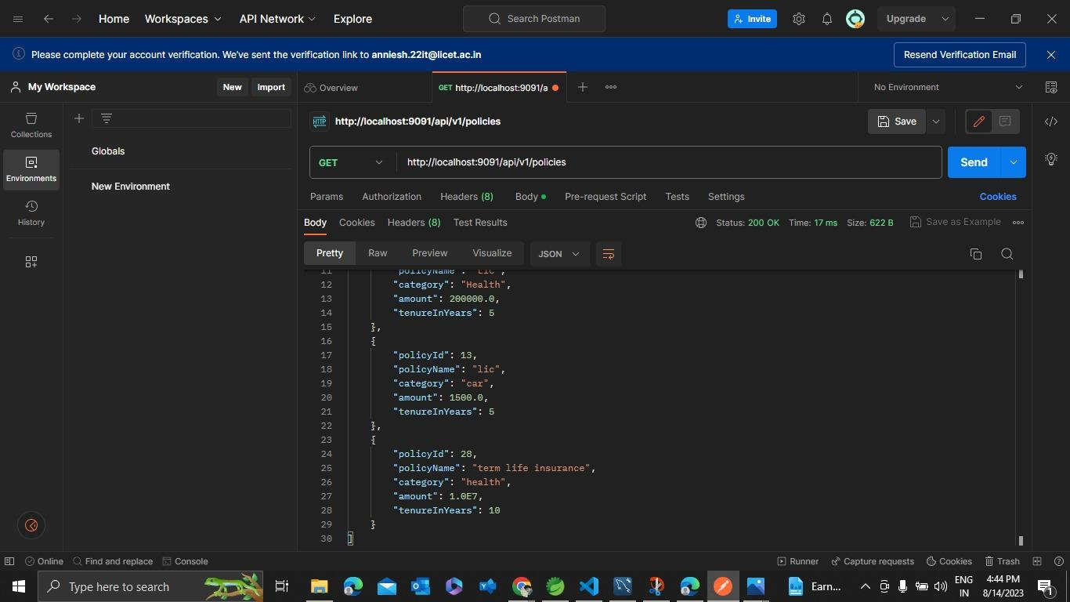

Slide 52
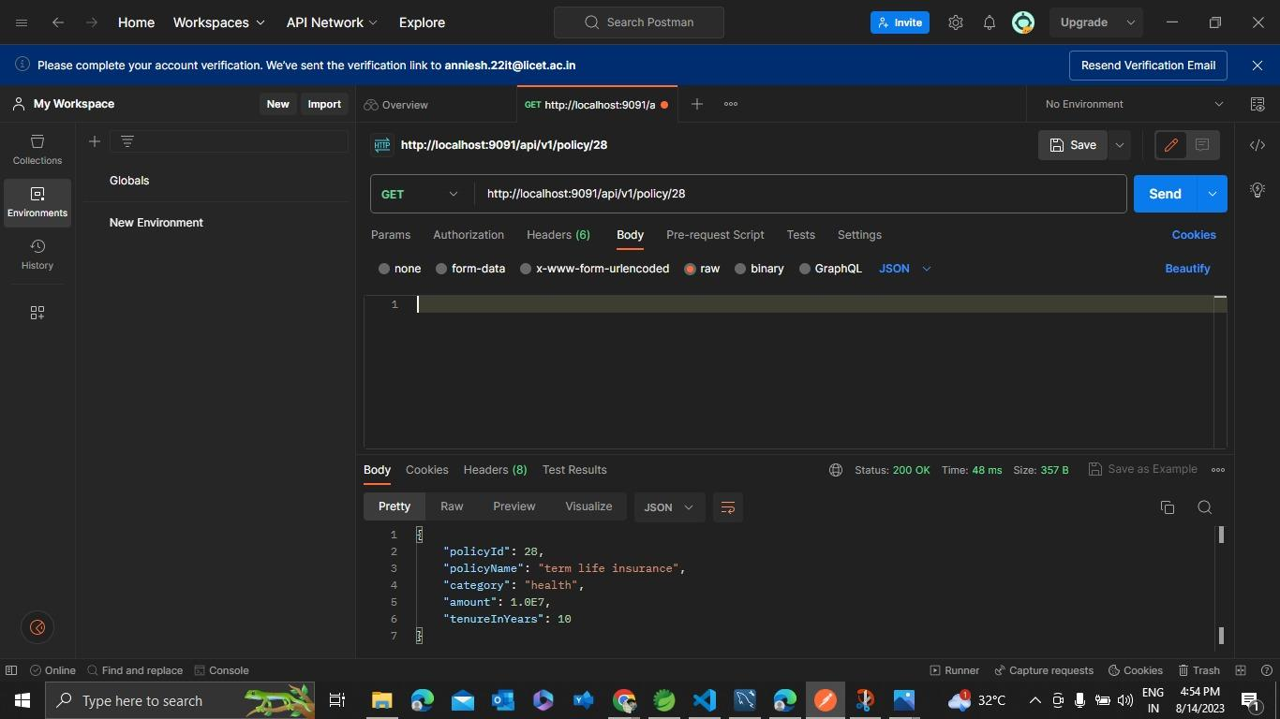

Slide 53
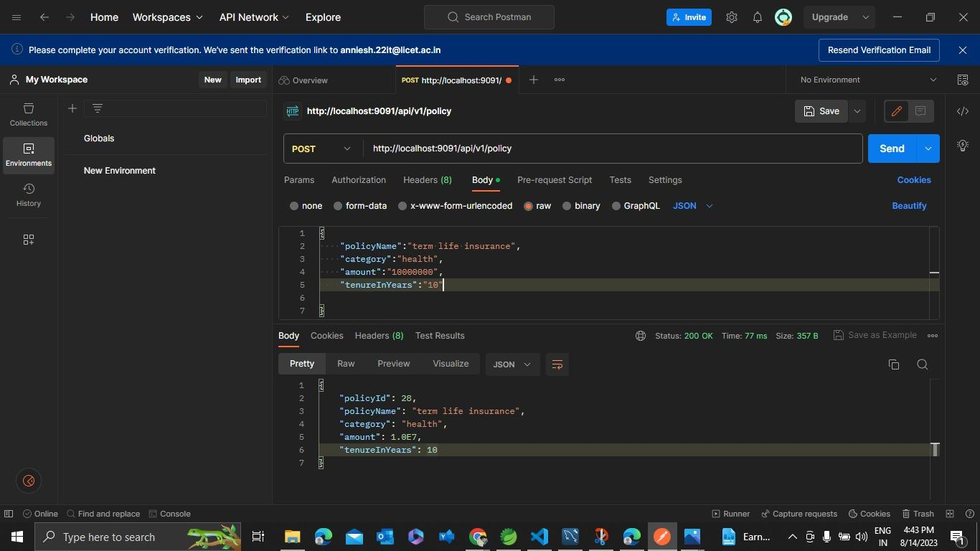

Slide 54
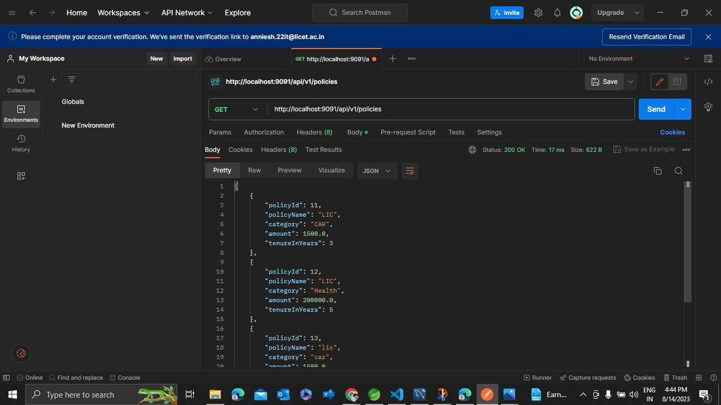

Slide 55
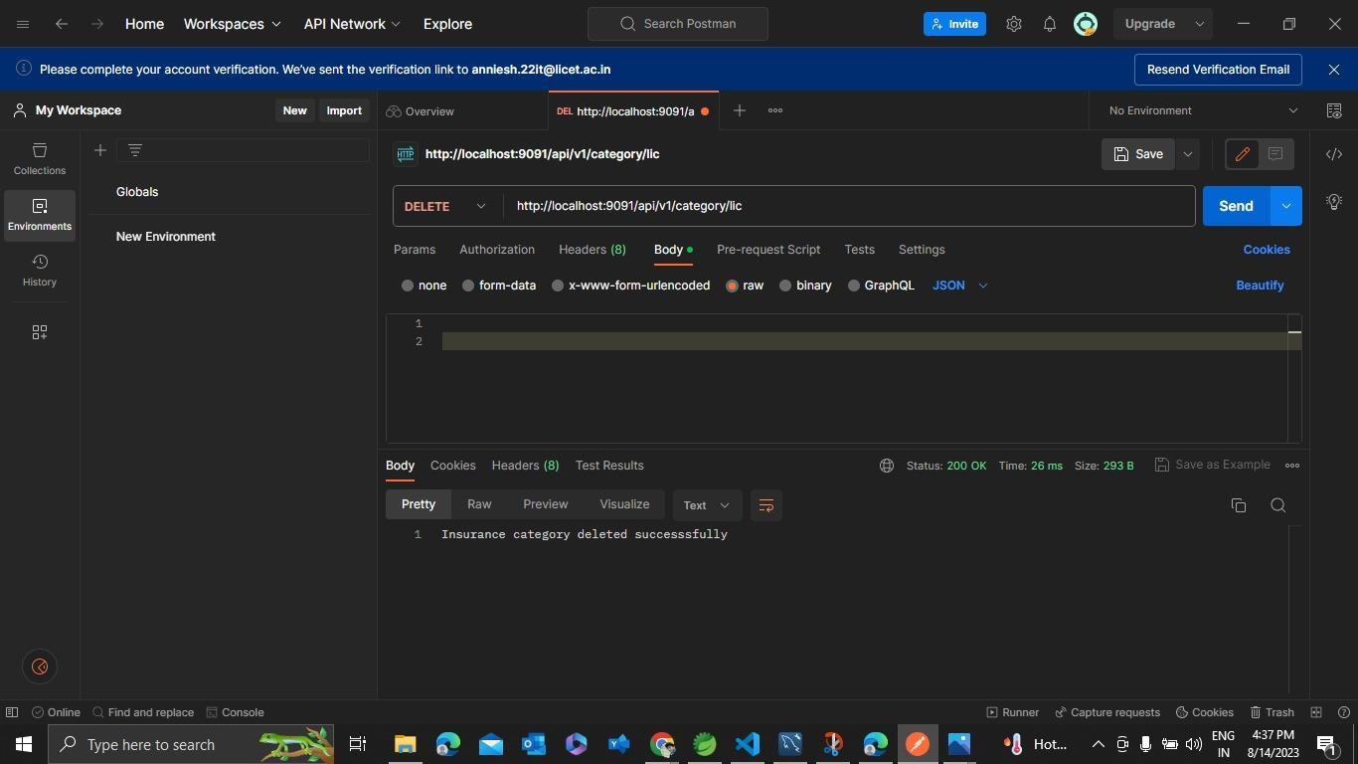

Slide 56
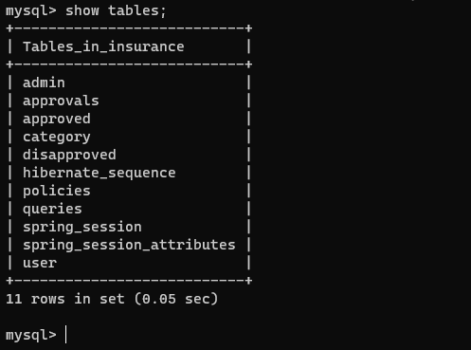
DATABASE TABLES

Slide 57
THANKS TO TEAM MATES 🙂
I am so lucky to work with you because you can bring innovative ideas and a fresh perspective on the project.
Thank you for your meticulous work on this project.
You guys have elevated this project with your hard work and great ideas. Thank you for your contributions. I really appreciate all of your efforts.

Slide 58


